Slide 1
Cafe Bunny
CZ3002 Advanced Software Engineering
Notes:
Hi, we’re Code Nation and this is our presentation for our App Cafe Bunny

Slide 2
Our Team
Mohamad Asyraaf Bin Abdul Rahman
Ong Yi Shen
Jordan Tan Rei Yao
Chew Zhi Kang
Ng Qin Wei
Bachhas Nikita
Project Manager
Lead Developer
Front-End Developer
Back-End Developer
Release Engineer/Manager
QA Manager and Engineer
Notes:
So this is our team, Im yi shen the project manager
Asyraaf is our lead developer
Jordan is our front end developer
Nikita is our back end developer
Zhi kang is our release engineer / manager
And Qin Wei is our QA manager / engineer

Slide 3
Product Introduction
01
Design for maintainability
02
TABLE OF CONTENTS
04
Project Management
Software Quality Assurance
03
05
Risk Management
Notes:
So this is our agenda for this presentation

Slide 4
01
Product Introduction
Notes:
Product introduction

Slide 5

Cafe Hopping
Cafe hopping is a popular trend among the younger demographic. It involves going to different cafes to take photos and give reviews.
In this era dominated by social media, cafe hoppers often post their photos on social media sites like Facebook and Instagram to show off to their peers.
Notes:
Cafe hopping is a popular trend among the younger demographic. It involves going to different cafes to take photos and give reviews.
In this era dominated by social media, cafe hoppers often post their photos on social media sites like Facebook and Instagram to show off to their peers.

Slide 6
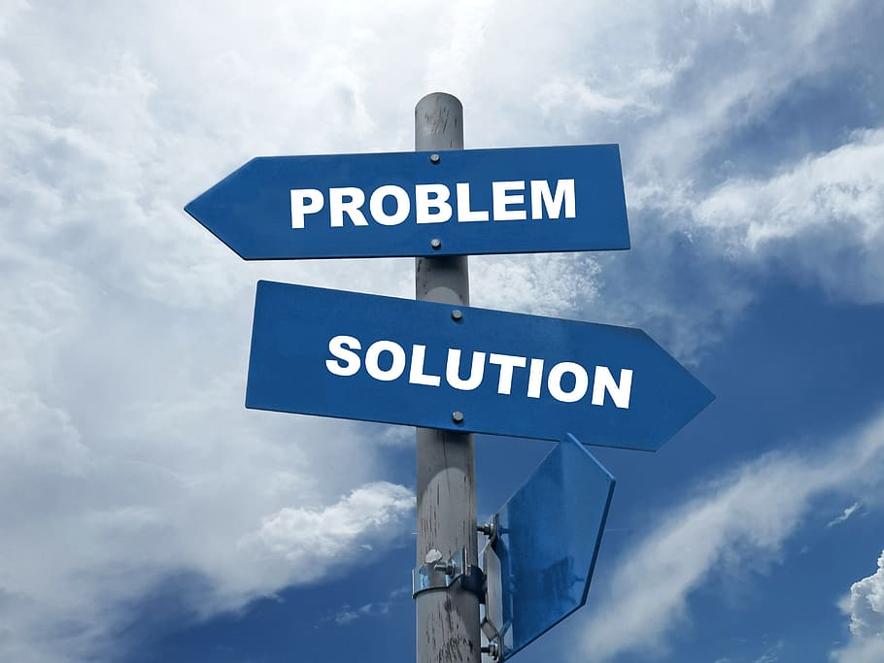
Problem
Keeping track of the various cafes that someone has been to can be an annoying process and besides through social media, cafe hoppers have no other way to show off their “achievements”.
Notes:
Keeping track of the various cafes that someone has been to can be an annoying process and besides through social media, cafe hoppers have no other way to show off their “achievements”.
So what is the solution to this problem?

Slide 7
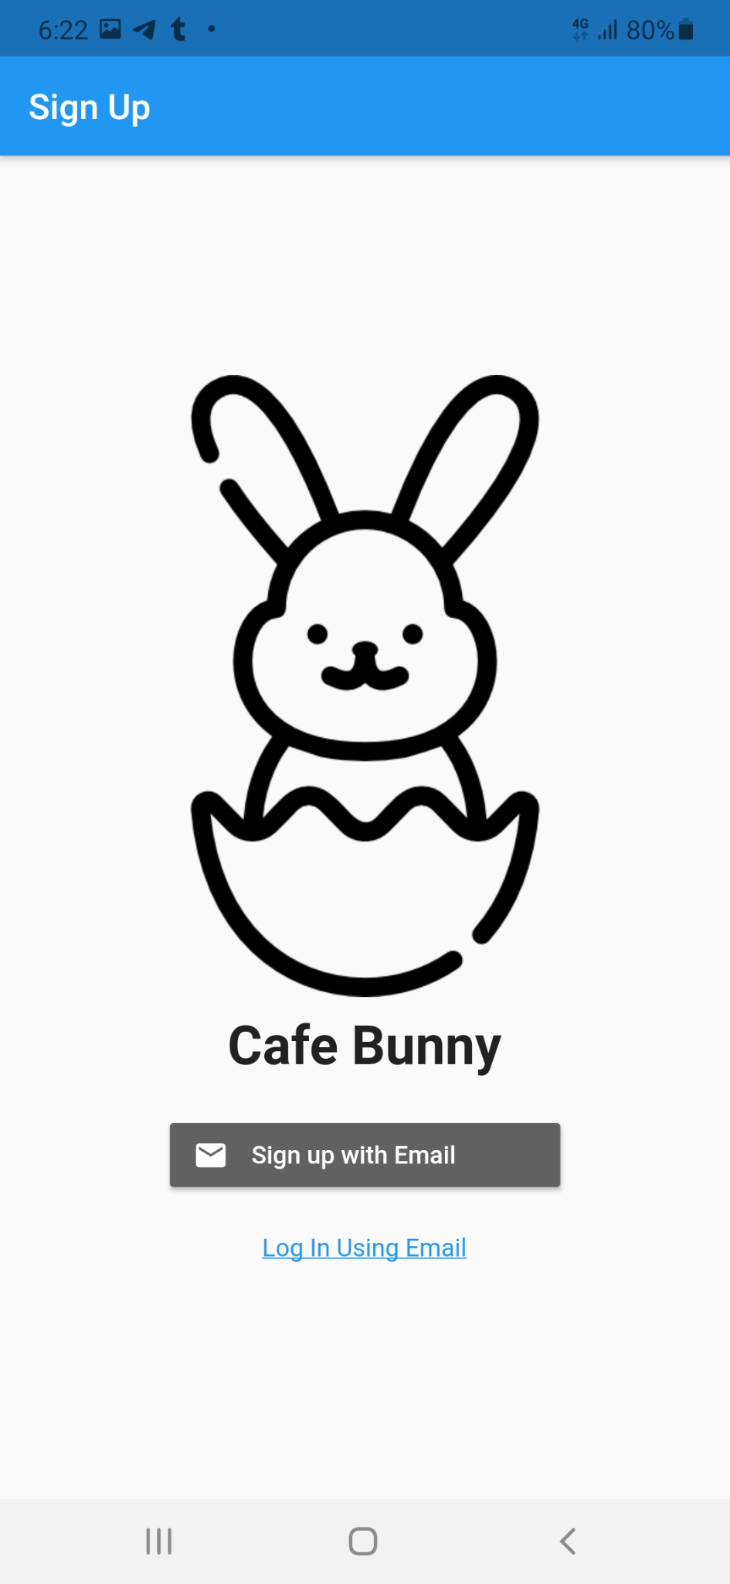
Cafe Bunny
Cafe Bunny is an application that aims to provide a useful platform for cafe hoppers
Keep track of the cafes that they have been to
Earn achievements and discount codes
Leave reviews of visited cafes
Notes:
Cafe Bunny is an application that aims to provide a useful platform for cafe hoppers by allowing users to keep track of cafes they have been to.
By visiting these cafes they can earn achievements and discount codes
The users can also leave reviews of cafes that they have visited

Slide 8
02
Design for maintainability
Notes:
Now i will talk about designing for maintainability

Slide 9

Flutter
Cafe Bunny is developed on Flutter software development kit.
It is a free and open source mobile UI framework created by Google.
Notes:
Cafe Bunny is developed on Flutter software development kit. It is a free and open source mobile UI framework created by Google.

Slide 10

Advantages of Flutter
One Codebase, Two platforms
Reduced Code Development Time
Similar to Native App Performance
Notes:
The advantages of Flutter
One Codebase, Two platforms, instead of maintaining 2 different codebases, one for android and one for iOS, flutter saves time by allowing a single codebase to work on both platforms
Reduced Code Development Time, flutter supports hot reloading, which allows for reloading the app while keeping its state to quickly view changes in code.
Flutter also comes with many ready to use widgets, which saves development time as well.
Similar to Native App Performance, flutter does not use any intermediate code representations and is built directly into the machine code unlike other multi platform frameworks

Slide 11
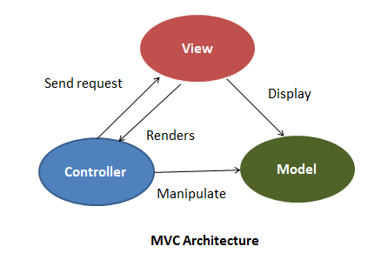
MVC
Separates program logic into three separate components, model, view and controller
Separation of concerns
Simultaneous development of different components
Easy to update and debug
Notes:
The design pattern that we are using is the well known MVC model view controller design pattern
The advantages of MVC are the separation of concerns, where each section is specialised in their own purpose
This separation allows for the simultaneous development of different components to further speed up development time
Another advantage is that it is easy to update and debug
I will now pass it over to Nikita

Slide 12
03
Software Quality Assurance
Notes:
Thank you! I will now go one to talk about the software quality assurance in our project.

Slide 13
Software Quality Assurance
Goals & Objectives
Ensure that the software developed does not deviate from the original intended product
Identify errors, omissions, inconsistencies, and alternatives, enhancements or improvements that can be at any stage of development
Notes:
The goals of SQA is to ensure that the software developed does not deviate from the original intended product, which means that we need to be able identify any errors, omission and inconsistencies made to the product.

Slide 14

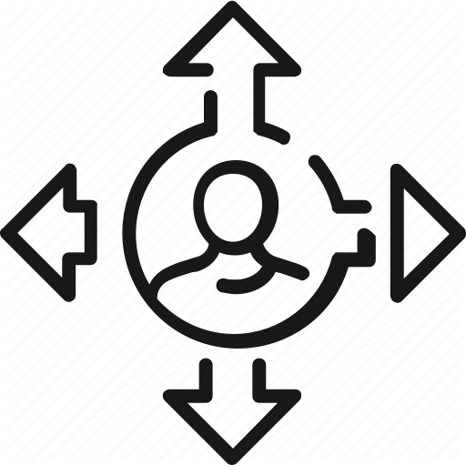




Software Quality Assurance
Responsibilities of QAM and Software Quality (SQ) Personnel
Secure and Manage SQ resource levels
Guidance and Direction to SQ Personnel
Develop and Maintain SQAM Plan
Maintain a SQA activities
Conduct Process and Product Assessment as planned in SQAM Plan
Identify and Report Findings, observations and risks related to QAM
Notes:
QAM must secure and manage sq resource levels and provide guidance and direction to sq personnel.
SQ personnel develop and maintain SQAM plan, maintain a sqa activities, conduct process and product assessment and identity any modification to be made in the software

Slide 15
Software Quality Assurance
Internal Attributes
External Attributes
Internal Attributes
External and Internal Attributes for SQAM
Maintainability:
Modifications: Corrections, Improvements or Adaptations
Changes in the environment in requirements and functional specifications
Reliability:
Maintain Performance Levels
Number of Procedure Parameters
Cyclomatic Complexity
Programme Size in Lines of Code
Length of User Manual
Cyclomatic Complexity
Programme Size in Lines of Code
Number of Error Messages
Notes:
We have identified 4 main software qualities that our product focuses on: functionality, usability, efficiency and maintainability.
Internal attributes stated here reflect the areas on ours developers have focused on to ensure that these external attributes are met.
Maintainability allows for the software to be modified according to the changes in environment and requirements while reliability means the product has to maintain at a certain level of performance under certain conditions for a period of time.

Slide 16
Software Quality Assurance
Internal Attributes
External Attributes
Internal Attributes
External and Internal Attributes for SQAM
Portability:
Able to be transferred between one environment to another
Inclusive of organisation, hardware or software
Usability:
Can be easily understood, used and is attractive to users
Number of Procedure Parameters
Programme Size in Lines of Code
Number of Error Messages
Length of User Manual
Notes:
Portability allows the product to be transferred from one environment to another while usability means that product is easy to understand and use without a significant learning curve.

Slide 17




Software Quality Assurance
Quality Assurance
Integration Testing:
Verification
Acceptance Testing:
Validation
Peer Reviews and Technical Reviews
Audits such as Baseline audits
Notes:
Now, we come to how our project’s software quality was assessed. Our quality assurance is Inclusive of integration testing, acceptance testing, reviews and audits.
All these methods ensure that each system component and the system as a whole meets the specific functional and non-functional requirements and maintains a high quality of performance at all time.

Slide 18
04
Project Management
Notes:
We now move on to the next portion, project management.

Slide 19
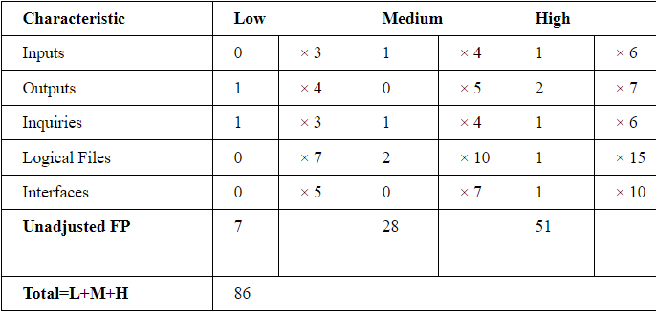
Project Management
Function Point Analysis
Unadjusted Function Point

Slide 20
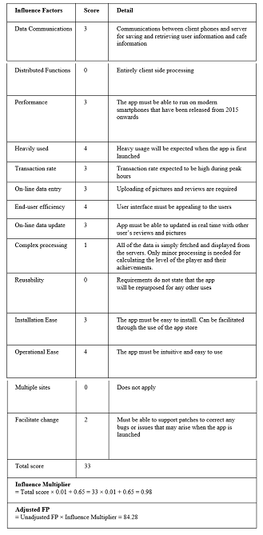
Project Management
Function Point Analysis
Influence Factors
Lines of Code = FP x LOC/FP | 84.28 FP × 26 LOC/FP = 2192 LOC
Effort = Size / Production Rate | (2192 LOC) / (39 LOC/PD) = 57 PD
Duration = 3 x Effort^(1/3) | 3 × (57) ^ 1/3 = 11.55 Days
Team Size = Person Days/Days | 57 PD / 11.55 D = 4.9 P = 5 People

Slide 21
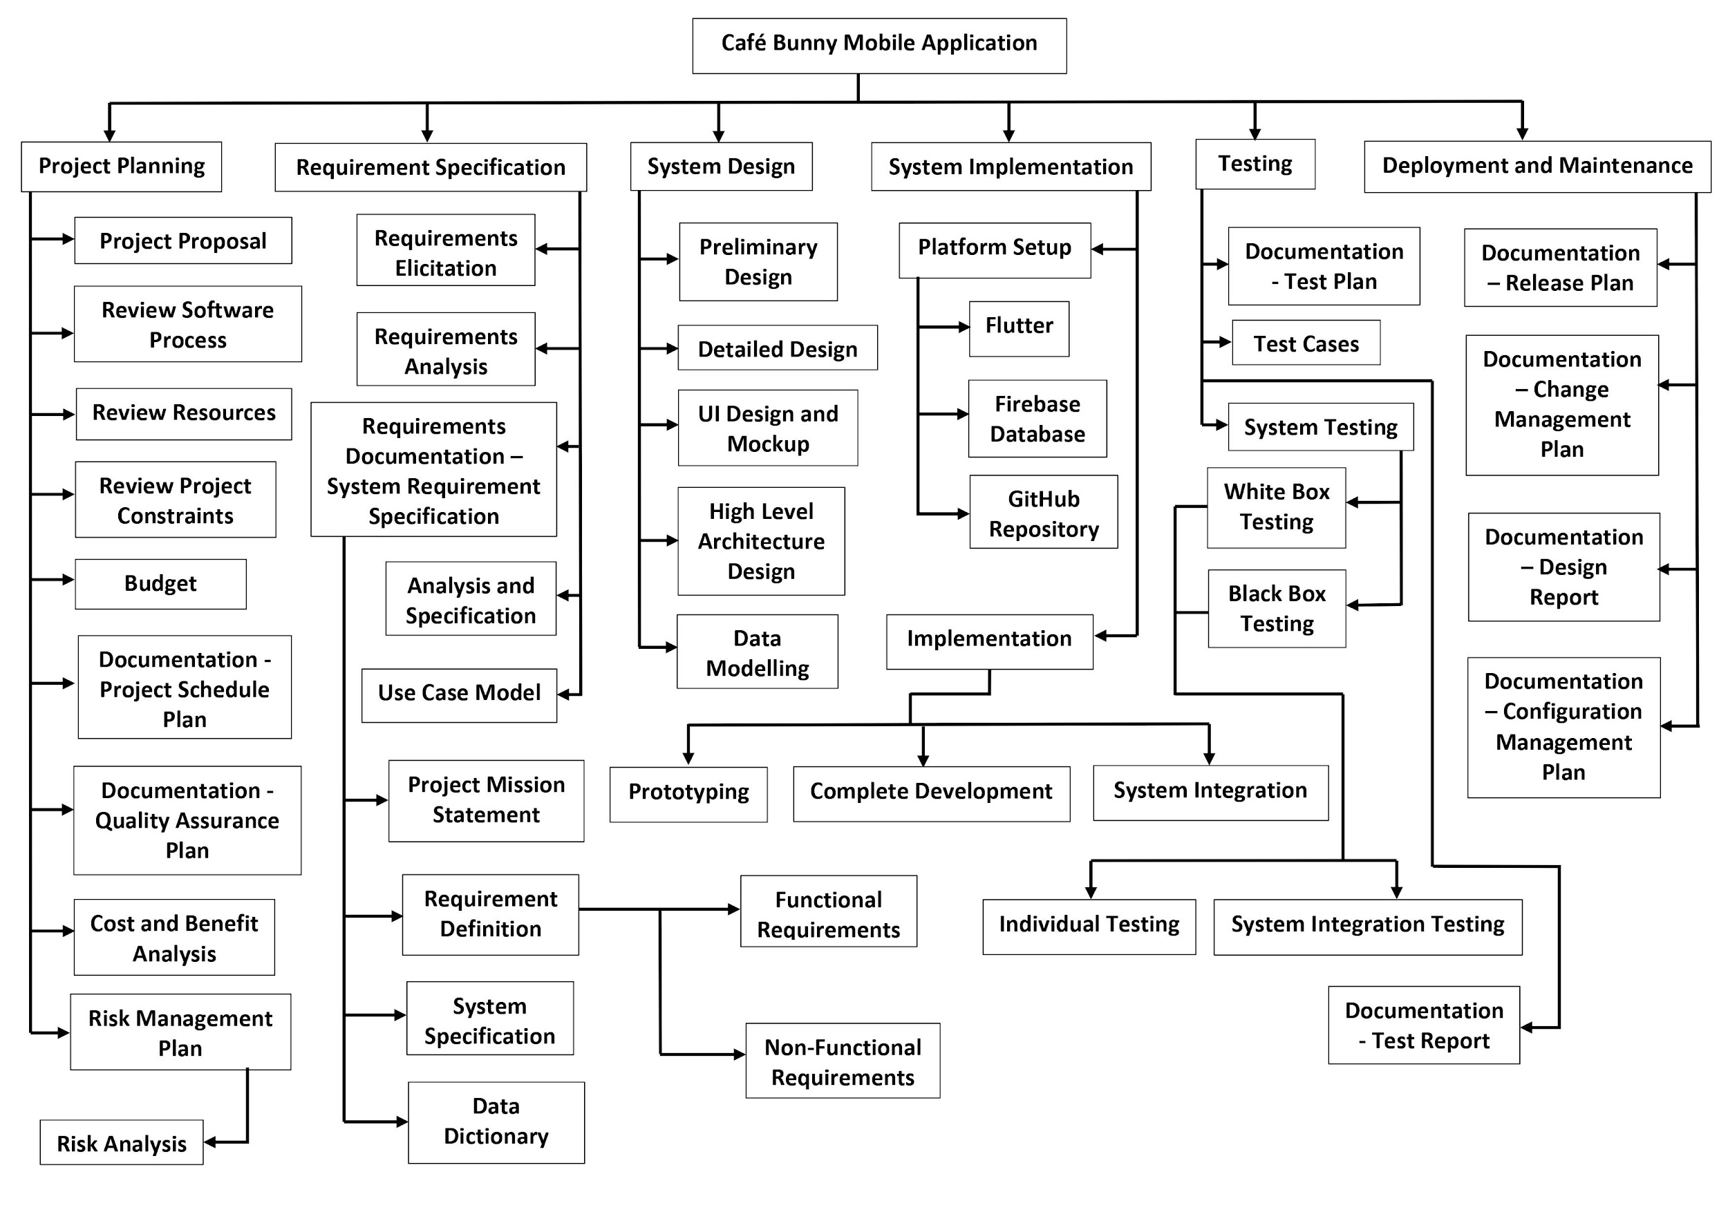
Project Management
Work Breakdown Structure
Notes:
Over here, you can see our wbs. We have split our project into 6 different stages: project planning, requirement specification, system design, system implementation, testing and deployment and maintenance.

Slide 22
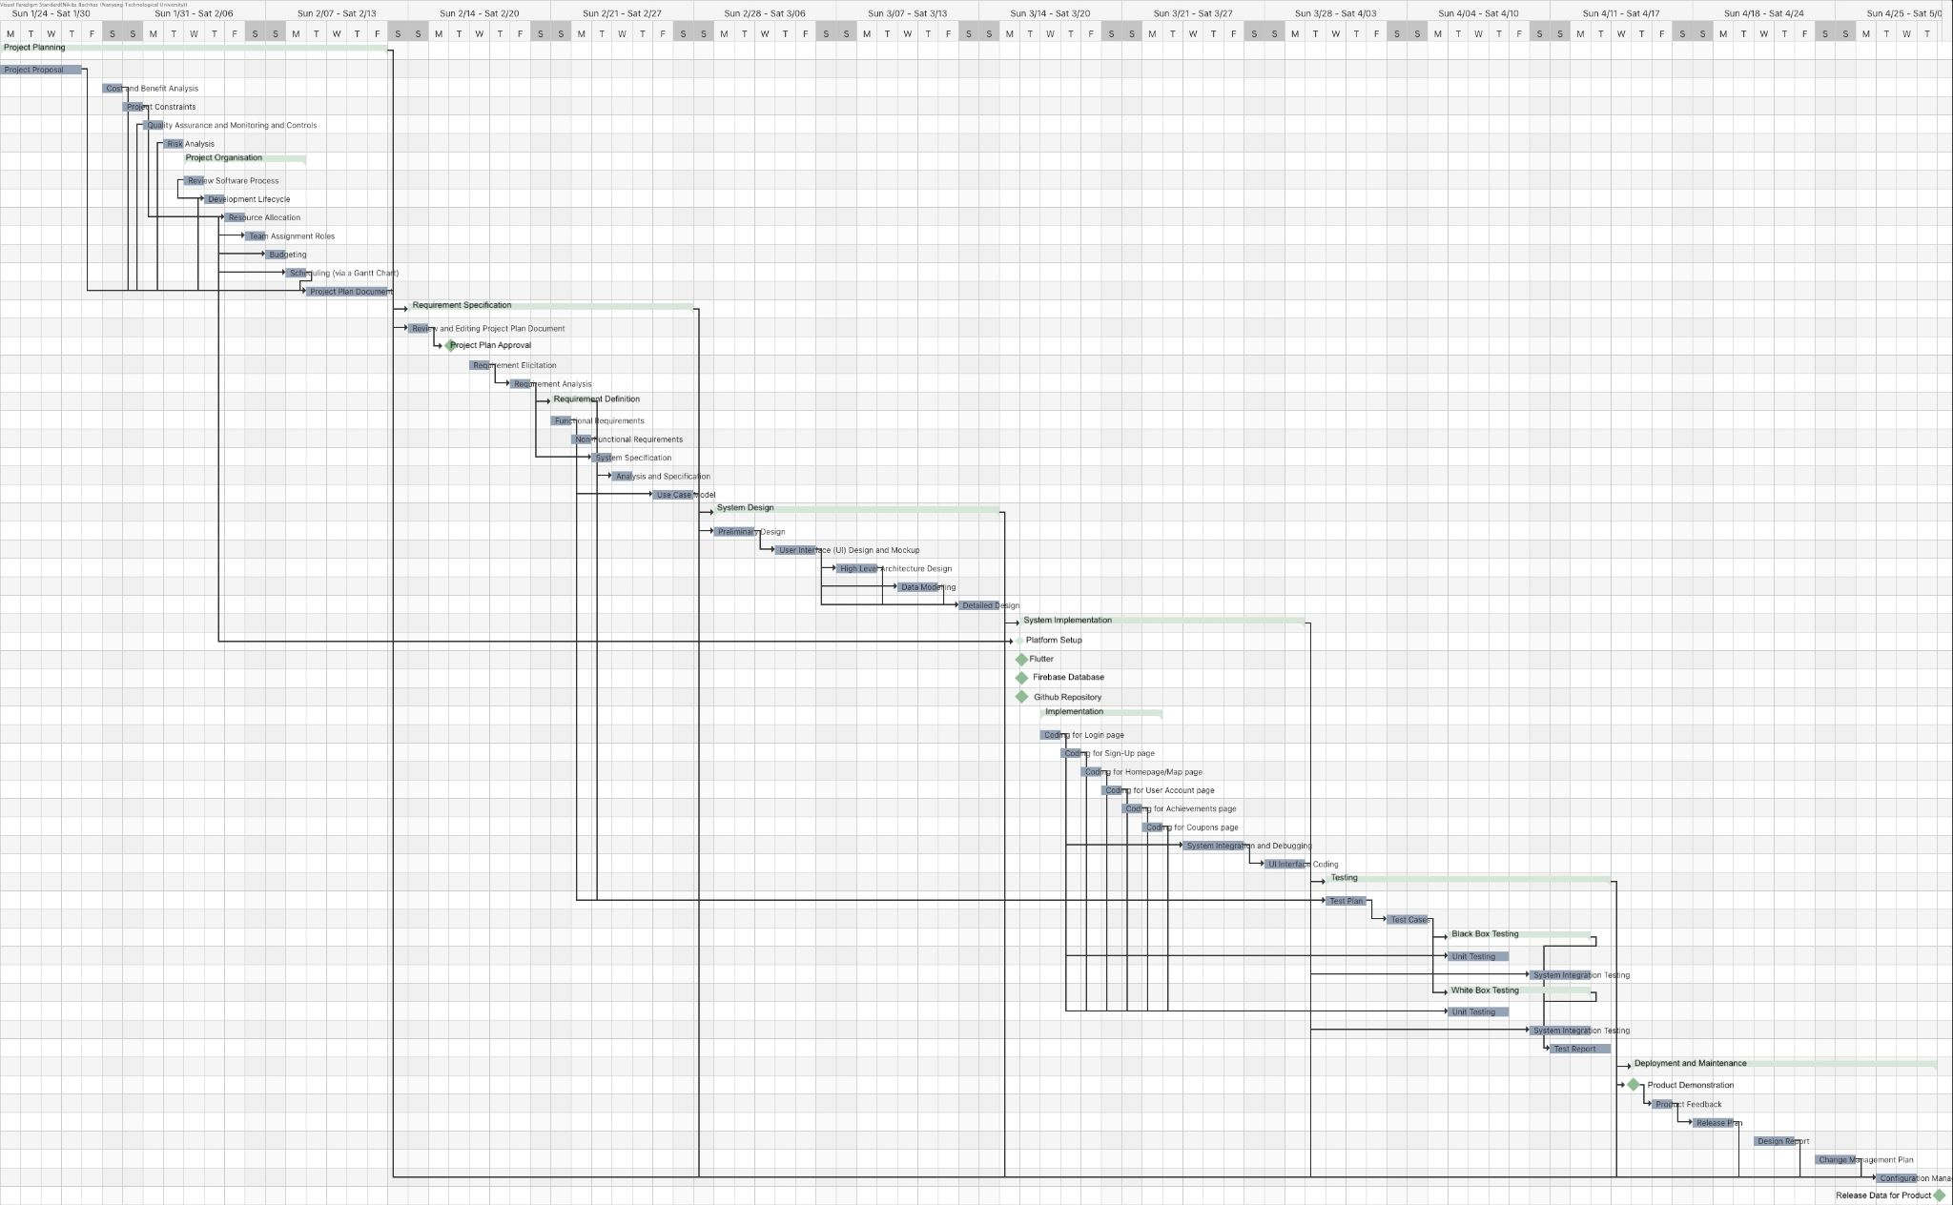
Project Management
Project Timeline
Notes:
Our project timeline shown in this Gantt chart is also split into 6 stages following our work breakdown structure.
The project is estimated to be carried over a period of a year, starting on 25th of January until the 14th of February

Slide 23
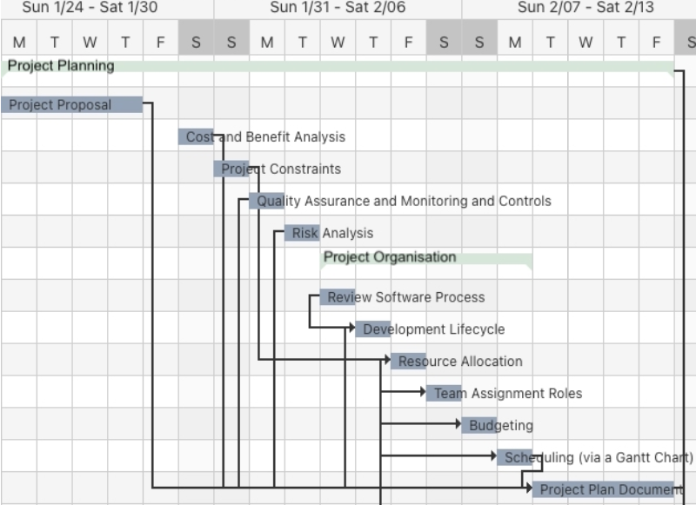
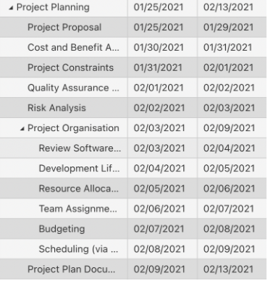
Project Management
Project Timeline
1st Stage: Project Planning
Notes:
Stage 1 is project planning and includes the initial few stages of project, starting from the project proposal.

Slide 24
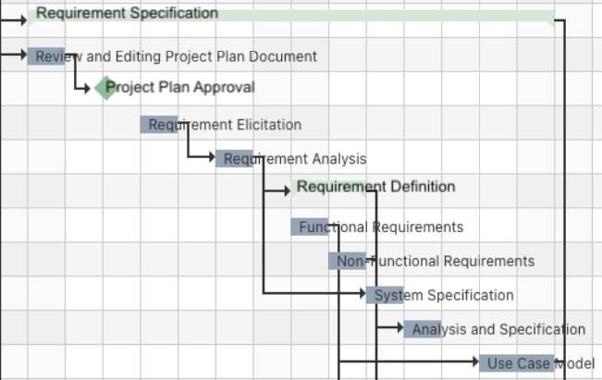
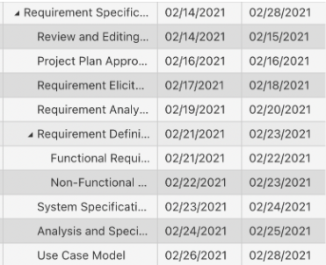
Project Management
Project Timeline
2nd Stage: Requirement Specification
Notes:
Includes requirement elicitation and analysis, finishing with the finalised use case model

Slide 25
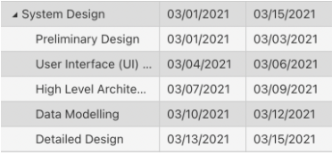
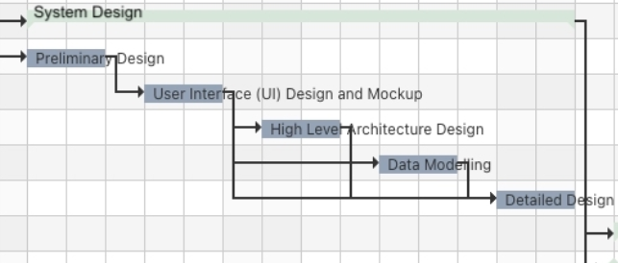
Project Management
Project Timeline
3rd Stage: System Design
Notes:
Different levels of designs, each going exploring a deeper depth of design for the system

Slide 26
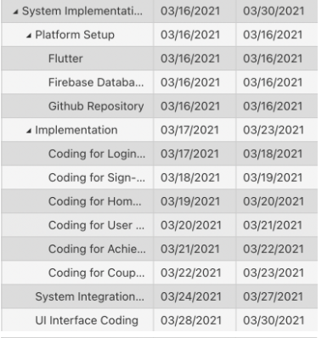
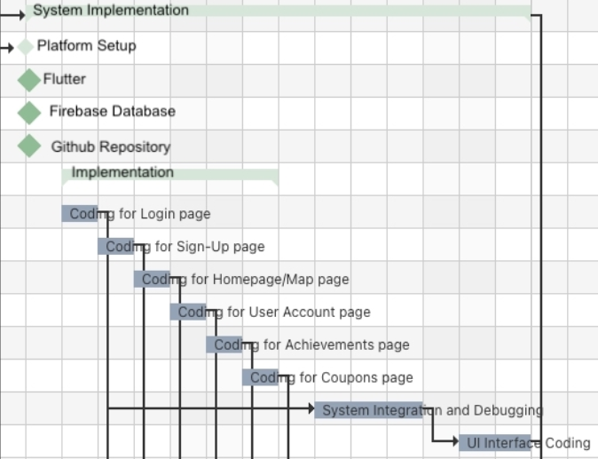
Project Management
Project Timeline
4th Stage: System Implementation
Notes:
Consists of prototyping exploring a small number of features before returning back to develop the entire product

Slide 27
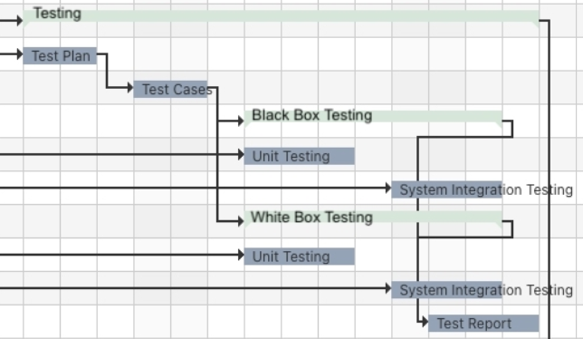
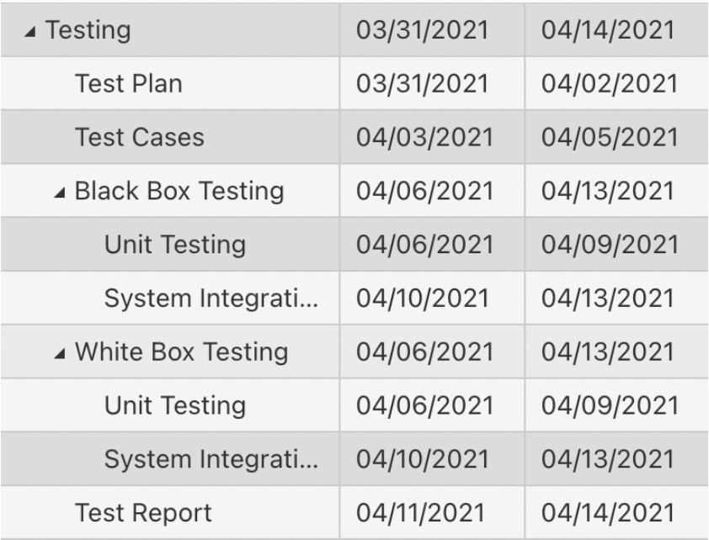
Project Management
Project Timeline
5th Stage: Testing
Testing for Prototype
Testing for Finished Product
Notes:
Splint into two stages

Slide 28
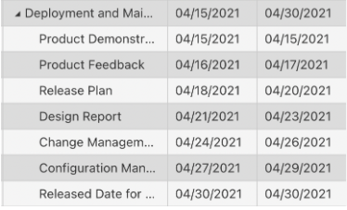
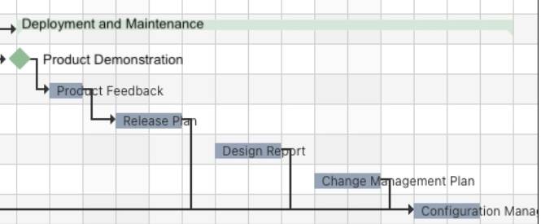
Project Management
Project Timeline
6th Stage: Deployment and Maintenance
Notes:
Include formation of various plans such as release, change management and configuration management to ensure future modifications, additions and improvements can be made to the product without any issues

Slide 29



Project Management
Team Communication
Google Drive
Storing of documentations/deliverables
Zoom
Communication, weekly online meetings
GitHub – Version Control System
Manage source code and Track changes

Slide 30
05
Risk Management

Slide 31
Risk Management
Risk Identification
Evaluating environmental factors, organizational culture, and project management plan
Risk management log generated to outline all risks and update as needed
Brief Description | Impact Description | Impact Level | Probability Level | Priority Level | Mitigation Notes | Owner
Brief summary of risk | What happens if the risk is not mitigated or eliminated | Rate 1-low to 5-high | Rate 1-low to 5-high | Impact X probability (Address highest first) | What can be done to reduce or eliminate the probability or impact | Who is responsible?

Slide 32
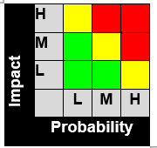
Risk Management
Risk Analysis
Determine which risks to pursue and respond to
Assessed based on probability and impact of occurrence
Risks in red and yellow zones will have risk response planning

Slide 33
Risk Management
Risk Response Planning
For each major risk, one of the following approaches will be selected to address it:
Approach | Description
Avoid | Eliminate threat by eliminating the cause
Mitigate | Identify ways to reduce probability or impact of risk
Accept | Nothing will be done
Transfer | Make another party responsible for the risks
Risk Monitoring, Controlling and Reporting
Level of risk tracked and reported throughout the project lifecycle
All project change requests will be analyzed for possible impact to project risks

Slide 34
Thank you!

